Slide 1
Analysis of Driving Distance and Scores on the PGA Tour
April 2023

Slide 2
Agenda
Introduction
Data
Hypotheses
Results
Discussion

Slide 3
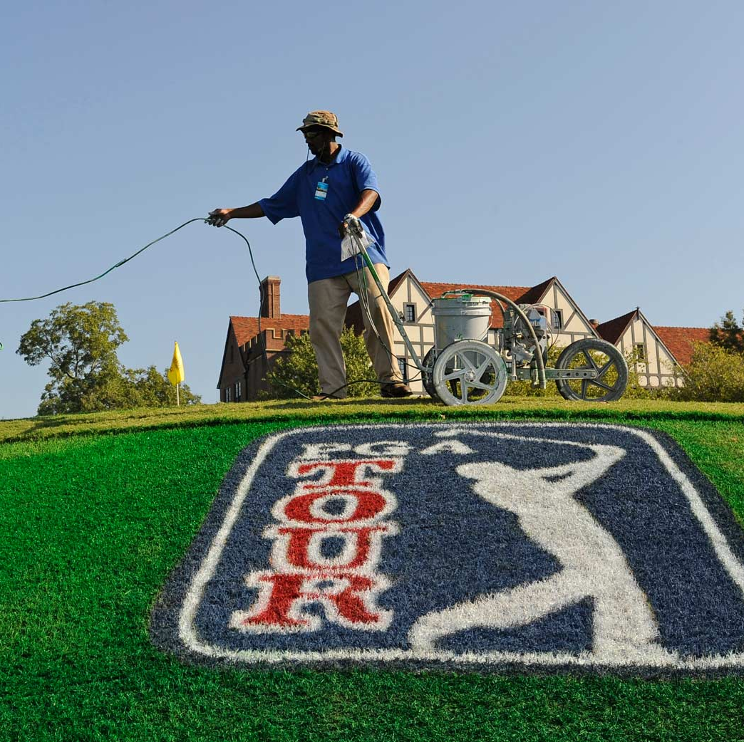
Introduction
In March 2023, the USGA, proposed a rule change which would ban golf balls that fly over 317 yards. This proposal has sparked a conversation about the need for such a major change, as it would have far spread implications ranging from player strategy to course design.
Focus of this analysis is on comparing PGA Tour players from 2022 and 2003 and on average how much difference there is between driving distance and overall scoring using A/B testing to determine if a change is warranted.

Slide 4
Data

Slide 5
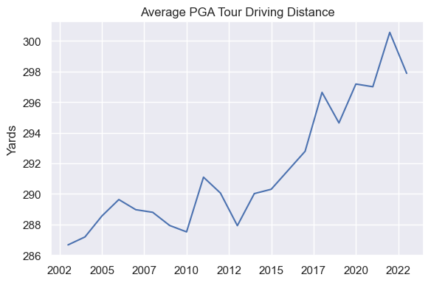
“Predictable, continued increases (in ball flight distances) will become a significant issue for the next generation if not addressed soon.”
Mike Whan, CEO of the USGA

Slide 6
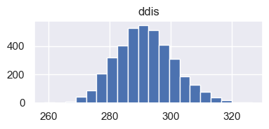
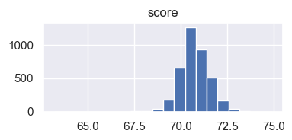
The Data
PGA Shot Tracker from ESPN
3832 records, 18 variables
20 years of player performance
Driving Distance (DDIS)
Score

Slide 7
Hypotheses

Slide 8
Hypotheses
 | Driving Distance | Score
H₀ | There is no significant difference between the average driving distances of current day PGA players and PGA players from 20 years ago. | There is no significant difference between the average scores of current day PGA players and PGA players from 20 years ago.
Hₐ | There is a significant difference between the average driving distances of current day PGA players and PGA players from 20 years ago. | There is a significant difference between the average scores of current day PGA players and PGA players from 20 years ago.

Slide 9
Methods and Results

Slide 10
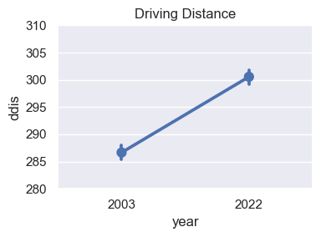
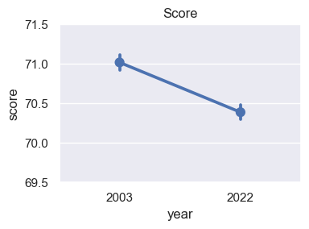
Statistically significant differences between 2003 and 2022 PGA Tour Players
Driving Distance
Score
With 95% confidence, the average driving distance is between 12.2 and 15.7 yards longer in 2022
With 95% confidence, the average score on Tour is between -0.8 and -0.5 strokes less in 2022
T-test assuming equal variances

Slide 11
Questions?

